Slide 1
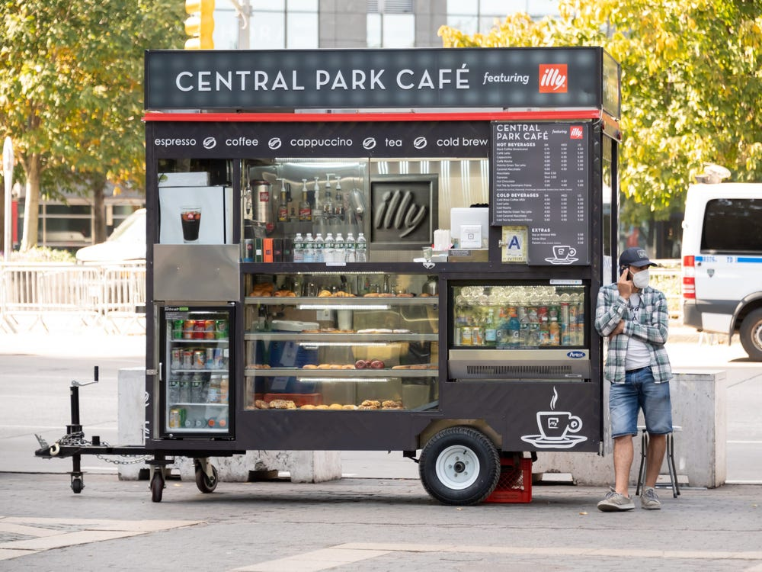
MTA Data Analysis of NYC Subway: Coffee Hours
Neshat Jalali Heravi​​
09/15/2921

Slide 2
Introduction
The objective of this EDA is to give insights on commuter traffic at New York City’s subway stations to coffee vendors!
“Before the pandemic, stopping at a food truck on the way to and from work was a New York City staple. But the work-from-home economy changed that, and vendors are suffering.” [1]
Businesses can use this information as part of their decision making to invest and manage their coffee trucks as NYC is going back to its new normal!

Slide 3
Methodology
Using the New York City subway data to analyse transit patterns of commuters in order to find the most crowded stations during coffee hours! (8AM – 5PM)
The analysis on the data provided by the Metropolitan Transportation Authority (MTA) is going to help us understand the commuter traffic at each station based on data logs from turnstiles.
Five month worth of turnstile data is analyzed (February - July of 2021). The analysis includes the entries and exits factors at each station per day and for each 4-hour periods
Analysis Tools
Python Libraries : Pandas, Numpy, Matplotlib, seaborn

Slide 4
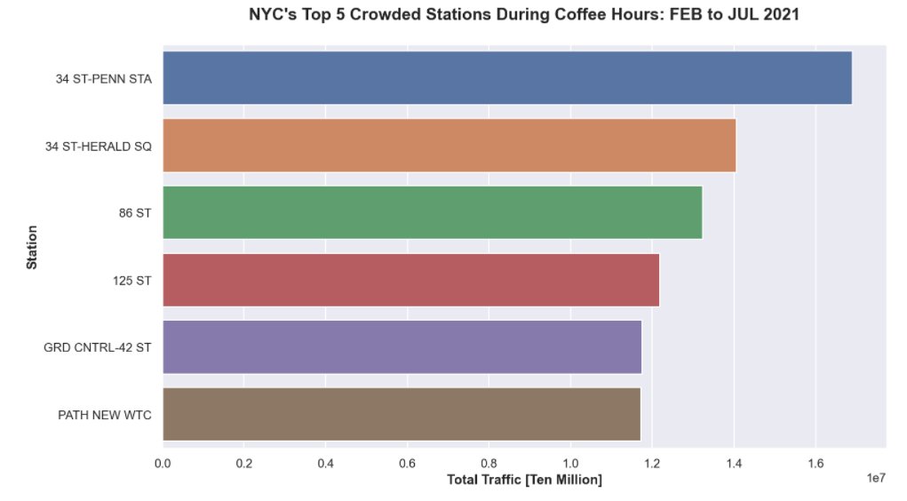
Results
The most crowded stations during coffee hours:
Penn Station
Herald Square
86 St.
125 St.
Grand Central
PATH NEW WTC
(World Trade Center)

Slide 5
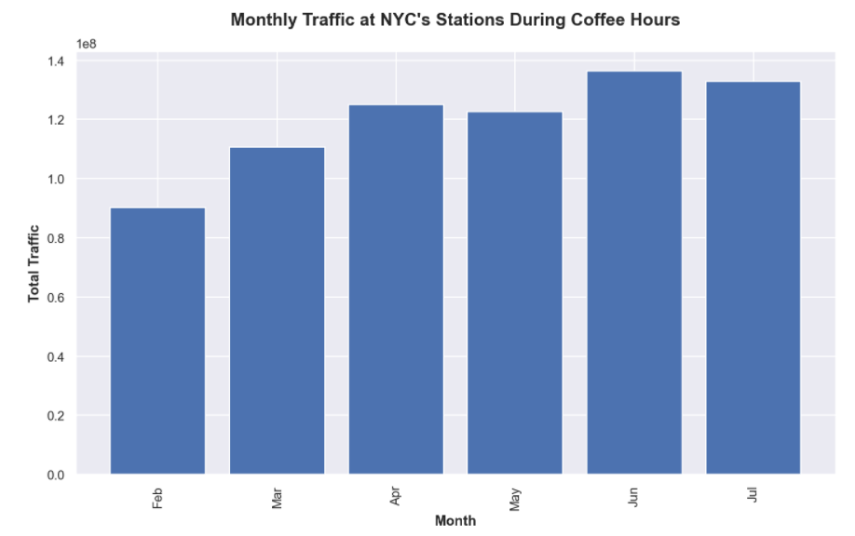
Results
NYC is going back to (new) normal as pandemic restrictions are lifting!

Slide 6
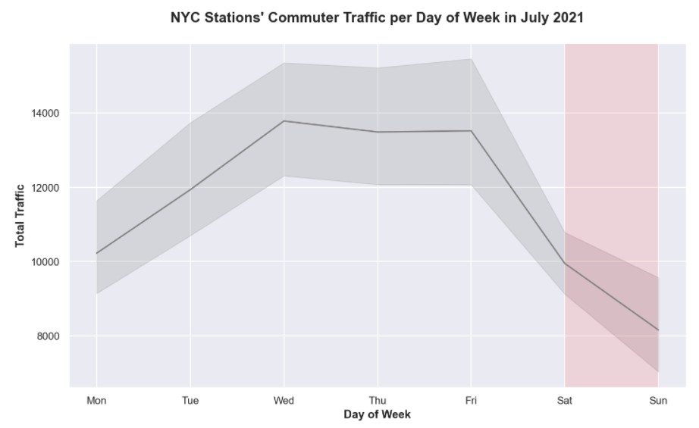
Results
Based on July’s data:
Commuter traffic is lower during weekends.
Wednesdays and Fridays are the most crowded.

Slide 7
Conclusion
Analyzing the commuter traffic data at NYC’s subways can give valuable insights for coffee vendors and investors who are looking into maximizing their revenue by picking the best locations!
Data shows an increase in commuter traffic from February to July!
Subway stations might not be the best option for coffee carts on the weekends!
It seems that subway peak traffic is no longer on Mondays!! [1]
​

Slide 8
Future Work
There should be more analysis on other factors involved in the decision making; such as labour cost for different hours, cost of parking the coffee cart at different locations etc.
An interactive analysis of the MTA data is recommended since the circumstances are constantly changing in NYC!
An analysis on pre-pandemic data is also recommended in order to grasp a sense of how the commuter traffic is changed during and post-pandemic!
Recommended Tools
Python Libraries : Using Folium and Geocoder libraries to extract the geographical coordination and make visualization maps
Other Visualization Tools: Tableau is a great tool for interactive analysis and storytelling

Slide 9
Citation
[1] “NYC food trucks are a microcosm of the changed economy. Mondays and Fridays are their slowest days, and many have changed locations.” by Ayelet Sheffy. https://www.businessinsider.com/nyc-food-trucks-work-from-home-economy-vendor-carts-postpandemic-2021-7

Slide 10
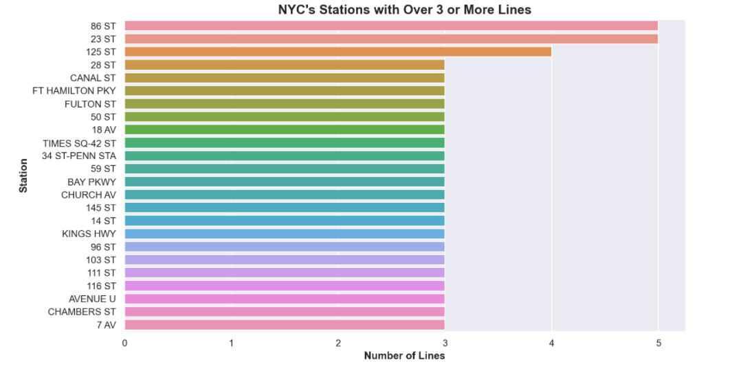
Abstract

Slide 11
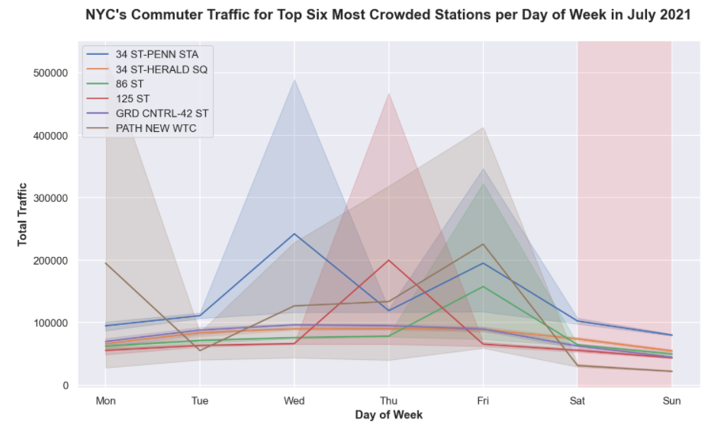
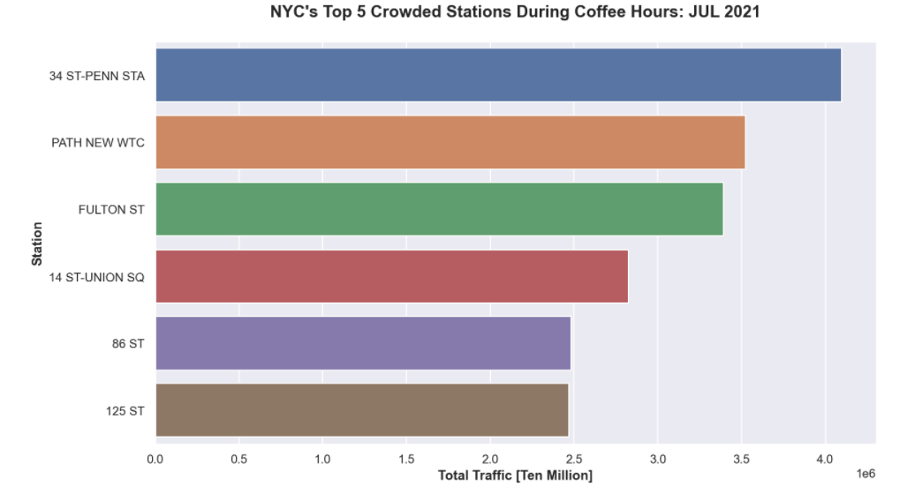
Abstract
Top 6 most crowded stations in July :

